Slide 1


Influence of Moisture Distribution in Soil on Pavement and Geothermal Energy
Md Adnan Khan, Ph.D., EIT
Supervisor: Jay X. Wang, Ph.D., P.E.
25th May 2017

Slide 2

Overview
Part I: Expansive Soil Research
Part II: Geothermal Energy Research
Conclusion
References
Acknowledgement

Slide 3
Flow Chart of Research
Identify the prominent types of expansive soil in North Louisiana which is Moreland clay.
Characterization of Moreland clay
Developing a closed-form analytical solution of pavement resting on expansive soil and verify the results with the filed study.
Evaluating the Moreland clay stabilization with cement and add water geopolymer.
Achievements: 3 journals, 2 conference papers (submitted)
Part I : Expansive Soil
Moisture Distribution in Soil
Achievements: 2 journals, 3 conference papers published.
A complete background study on Geothermal Energy and its Potential use in Louisiana.
Study on Energy Foundation Design in South Louisiana.
Sensitivity analysis of different design parameters of South Louisiana’s energy foundation.
Development of a Graph Method for Preliminary Design of Borehole Ground-coupled Heat Exchanger in North Louisiana.
Part II : Geothermal Energy
Figure 1. Research Summary

Slide 4
Part I: Expansive Soil Research

Slide 5
Problem Statement and Improvement
Problem:
Northern Louisiana’s expansive soil and its heave potential has not been well addressed or corresponding research has not been well documented in Louisiana.
Research Goal:
Identify the major type of expansive soil in north Louisiana.
Distribution of Northern Louisiana’s expansive clay map of the USA
Through a series of experiments a complete characterization of Moreland Clay.
Comparison of Moreland Clay expansivity with expansive soils present in other parts of the world.

Slide 6
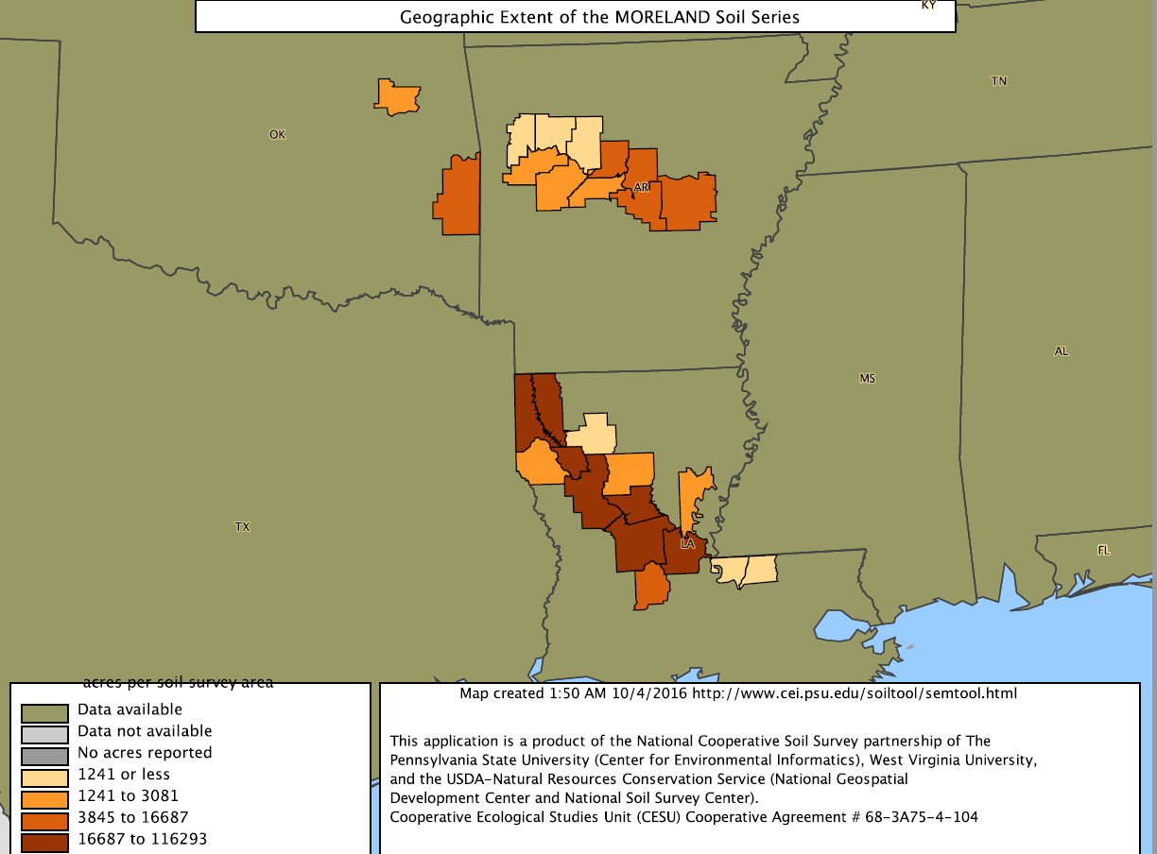
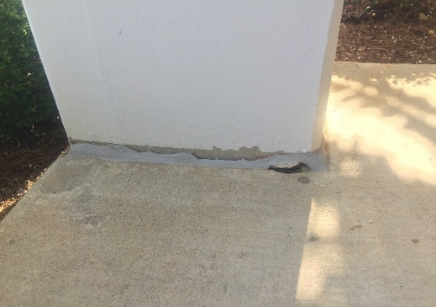
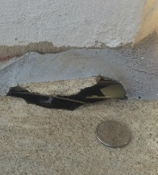
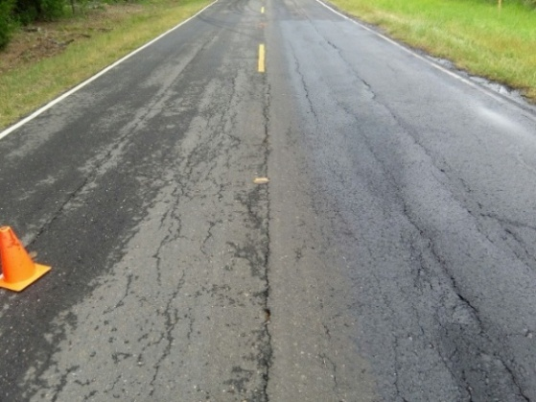
Moreland Clay Distribution
(a)
(c)
(b)
(d)
Figure 2. (a) Moreland clay map of USA, (b) Cracks in the Joint, (c) Zoomed picture and (d) longitudinal cracks in pavements

Slide 7
Characterization of Moreland Clay
Table 1. A List of Performed Regular Soil Test
Soil Property | Test Standard | Value
Specific Gravity | ASTM D854 - 10 | 2.75
Sieve Analysis | ASTM D422-63 | #200 passing 99%
LL, PL and PI | ASTM D4318 - 10 | LL = 79, PL = 28 and PI=51
USCS Soil Classification | ASTM D2487 - 11 | Fat Clay (CH)
Standard Proctor Test | ASTM D698 – 12 (Method A) | γ_{d (max)} =14.52 kN/m³, w_{OPT} = 27%
Bulk Density | ASTM C914 - 09 | 1.24 gm/cm³
Regular Soil Test

Slide 8
Characterization of Moreland Clay
Table 2. A List of Performed Expansive Soil Test
Soil Property | Test Standard | Value
1-D Soil Swelling | ASTM D4546 - 14 | 0.00508 m (0.2 in)
Consolidation Test | ASTM D2435 / D2435M - 11 | C_{C} = 0.36 and C_{S} =0.11
Swelling Pressure | [1] | Corrected value 180 kPa
SWCC test | ASTM D6836 - 02 | Figure 13
Shrinkage Test | [2] | Figure 14
Modified Shrinkage Test | [3] | Figure 15
Direct Shear Test | ASTM D3080-98 | Figure 16 𝒄 ʹ = 23 kPa; 𝝋 ʹ = 18.80⁰
Expansive Soil Test

Slide 9
Summary of the Laboratory Tests
Table 3. Summary of the Laboratory Tests of Moreland Clay
Soil Properties | Value | Soil Properties | Value
USDA soil taxonomy classification | Very-fine, smectitic, thermic Oxyaquic Hapluderts | Bulk Density, gm/cm³ | 1.24
USCS soil classification | Fat clay | Bulk volume moisture content | 41.04
USCS soil symbol | CH | Free soil swelling, in | 0.101
Specific Gravity, G_{s} | 2.75 | Expansion Index, EI | 101
Liquid limit, LL | 79 | Activity of clay, A_{c} | 1.37
Plastic limit, PL | 28 | Compression Index, C_{c} | 0.36
Shrinkage limit, SL | 9 | Swell Index, C_{s} | 0.11
Plasticity Index, PI | 51 | Corrected Swelling Pressure, KPa | 180
Opt moisture Content | 27% | Avg. Field Moisture content (%) | 32
Max dry unit weight (kN/m³) | 14.52 | Avg. Saturated Moisture content (%) | 52
Average field void Ratio,e0 | 1.27 | Saturated unit weight (kN/m³) | 19.70
Field unit weight (kN/m³) | 17.11

Slide 10
Heave Prediction of 1-m Moreland Clay
Table 4. A Comparison of Expansive Soil in Different Places Based on the Swell Percent [4-7]
Predominant Soil Type | Swell = (ΔH/H)*100% | Results/Location
Moreland clay (CH) | 7.22 | Predicted value/Bossier City, Louisiana
Regina clay (CH) | 7.78 | Predicted value/Regina, Canada
Grayson | 9.8 | Lab test
Colorado | 8.2
San Antonio | 7.3
Oklahoma | 3.8
San Diego | 3.4
Denver | 6.5-7.4 | Lab test
Pierre Shale | 3.1-5.7
London clay (CH) | 2.12 | Predicted value/Chattenden, Kent, UK
Maryland clay (CH) | 3.56 | Predicted value/Newcastle, Australia
Kenswick clay (CH) | 1.76 | Predicted value/Adelaide, Australia
Arlington clay (CL-CH) | 1.35 | Predicted value/Arlington, Texas, US
Al-Ghat shale(CH) | 3.53 | Predicted value/Al-Ghat, Riyadh, Saudi Arabia
Zaoyang soil (CL-CH) | 1.03 | Predicted value/Zaoyang, Hubei, China

Slide 11
Part II: Developing a Methodology to Analyze Pavement on Expansive Soil

Slide 12
Problem Statement and Improvement
Problem:
There is no closed-form solution for a pavement resting on expansive soils. In regular engineering practice using finite element software to design a pavement is not feasible and thereby there is a need for a simplified solution which can be done using spreadsheets.
Research Goal:
A closed-form solution of a pavement resting on expansive soil is developed.
This developed analytical method can be used to calculate deflection, rotation, bending moment and shear force due to subgrade soil’s volume change.
The solution of the closed-form is then verified from the field observation.

Slide 13
Virtual Load
In Short this innovative idea will help to transform problems from expansive soil to regular soil
Beam deflection on expansive soils
Beam deflection on regular soils with the help of a virtual load
One of the Major Contributions of My Ph.D.

Slide 14
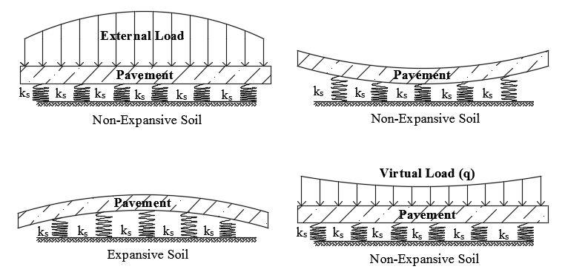
Diagram of Virtual Load
(a)
(c)
(b)
(d)
Figure 3. (a) Pavement on a Non-Expansive Regular Soil, (b) Pavement Deflection Due to External Load, (c) Pavement Deflection Due to Expansive Soil’s Volume Change, and (d) The Proposed Virtual Load Soil Model

Slide 15
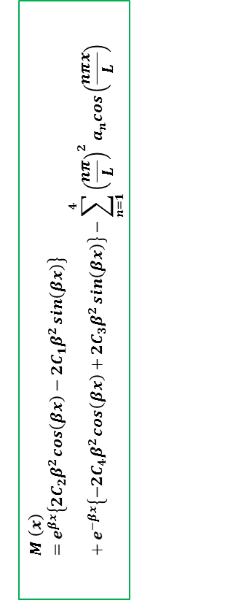
Extreme Shrinkage Bending Moment of Beam for Texas FM2 Road
2.2 m
$$M \left(x\right)=e^{βx}\left\{2C_{2}β^{2}\cos\left(βx\right)−2C_{1}β^{2}\sin\left(βx\right)\right\}+e^{−βx}\left\{−2C_{4}β^{2}\cos\left(βx\right)+2C_{3}β^{2}\sin\left(βx\right)\right\}−\sum_{n=1}^{4}{{\left(\frac{nπ}{L}\right)}^{2}a_{n}cos\left(\frac{nπx}{L}\right)}$$
Figure 4. Extreme Shrinkage Condition Beam Bending Moment

Slide 16
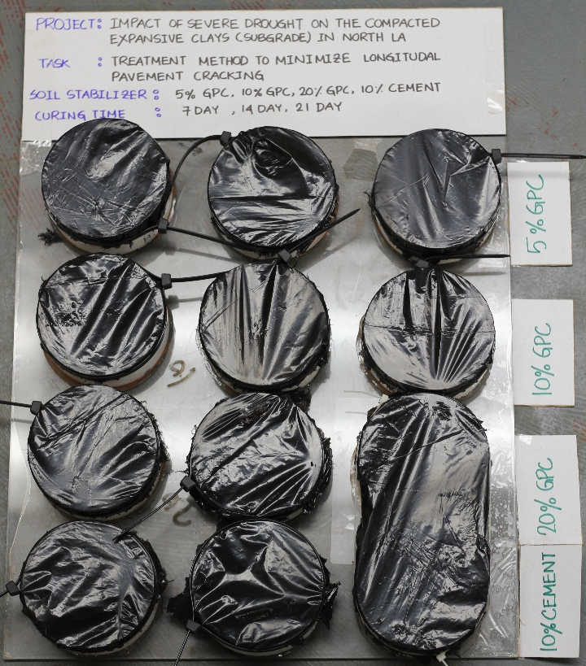
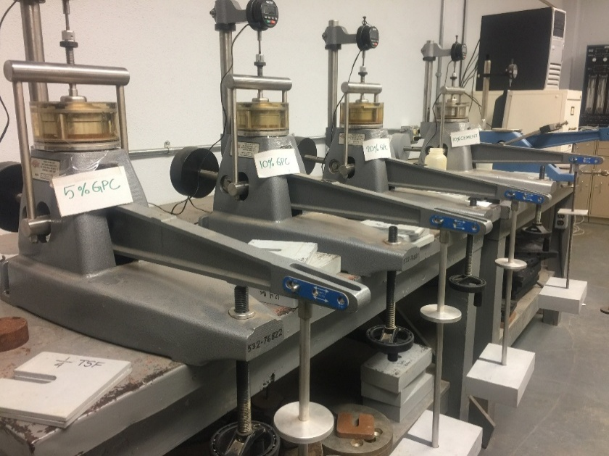
Moreland Clay Stabilization
(a)
Figure 5. (a) Stabilized Soil Samples Under Curing Process (b) Consolidation Test of Stabilized Samples
(b)

Slide 17
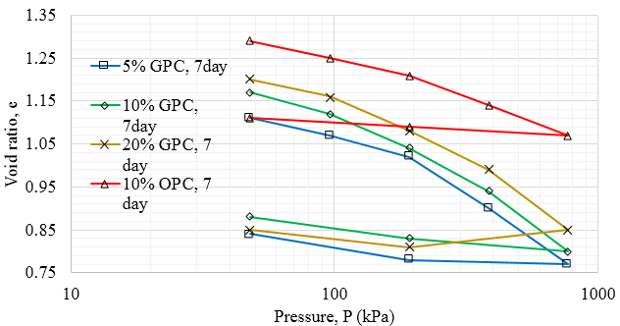
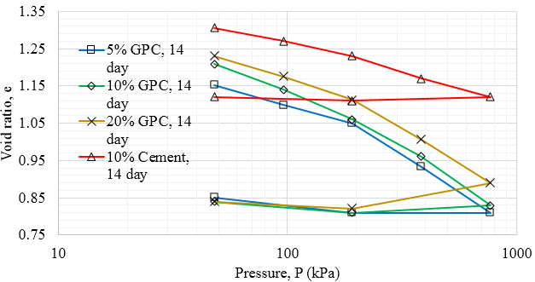
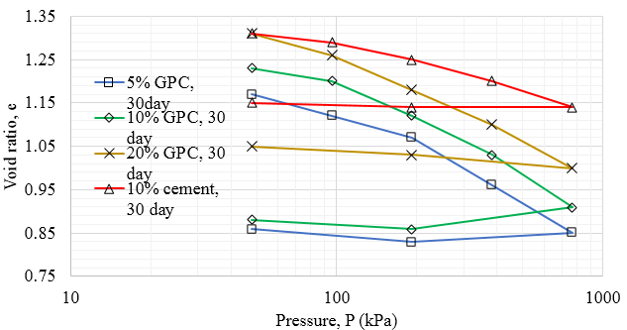
Consolidation Test of Stabilized Moreland Clay
(a)
(b)
(c)
Figure 6. Soil Stabilization (a) 7-day, (b) 14-day and (c) 30-day

Slide 18
Part II: Geothermal Energy

Slide 19
Problem Statement and Improvement
Problem:
There is no well-documented research on the prospect of geothermal energy in Louisiana.
For small house/office space there is a need for an easy and quick way to preliminary design of a vertical heat exchanger system.
Research Goal:
Pile foundation of a building in South Louisiana is designed as an Energy Pile heat exchanger.
For north Louisiana a simplified graph method is proposed for a quick design of a Borehole heat exchanger.
Sensitivity analysis is performed for different design parameters of an Energy Pile heat exchanger.

Slide 20
North Louisiana Heat Exchanger
Figure 7. A schematic diagram of a borehole heat exchanger in summer and winter

Slide 21
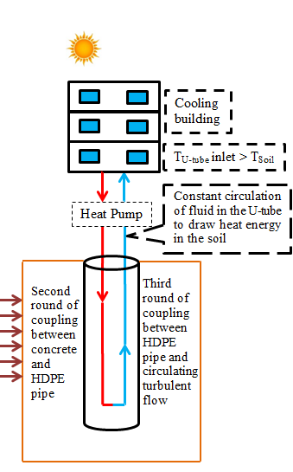
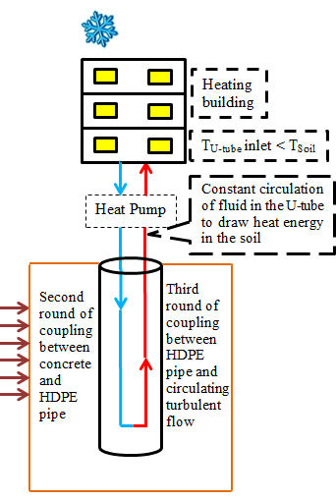
South Louisiana Heat Exchanger
Figure 8. A schematic diagram of a energy pile exchanger in summer and winter

Slide 22
Study on Energy Foundation Design in South Louisiana (contd.)
Table 5. Total Output of Energy Pile
Cooling load kW/hr | Max Demand | 147.27
 | Extraction from Energy Pile | 29.31
 | % | 19.9
Heating load kW/hr | Max Demand | 39.54
 | Extraction from Energy Pile | 26.93
 | % | 68.12
Table 6. Comparison Between Different Types of Energy Sources
Type of Energy Source | Cost Comparison | CO₂ Emission Comparison
Natural Gas | 13.6 | 1.8
Propane | 17.6 | 1.6
Oil | 19.0 | 1.8
Electrical heat | 16.0 | 1.7
Geothermal | 1.0 | 1.0

Slide 23
Conclusion`
Expansive Soil
Moreland clay is highly expansive soil.
Developed analytical model gives a simple analytical solution to design a pavement resting on expansive soil.
Geopolymer can used an effective stabilizer of Moreland clay.
Geothermal Energy
In both northern and southern Louisiana shallow depth heat exchanger is an economical alternative.

Slide 24
Acknowledgement
SPTC under the contract No SPTC14.1-76.
National Science Foundation(NSF) and the Louisiana Board of Regents (BOR) at the program of EPSCoR-Pfund under the contract No. LEQSF(2012)-PFUND-286.

Slide 25
References
[1] D. G. Fredlund, "Consolidometer test procedural factors affecting swell properties," in Proceedings of the Second International Conference on Expansive Clay Soils, Texas A & M Press, College Station, TX, 1969, pp. 435-456.
[2] J.-L. Briaud, X. Zhang, and S. Moon, "Shrink test-water content method for shrink and swell predictions," Journal of Geotechnical and Geoenvironmental Engineering, vol. 129, pp. 590-600, 2003.
[3] X. Zhang, "Consolidation theories for saturated-unsaturated soils and numerical simulation of residential buildings on expansive soils," DOCTOR OF PHILOSOPHY, Department of Civil Engineering, Texas A&M University, College Station, TX, 2004.
[4] H. Tu, "Prediction of the Variation of Swelling Pressure and 1-D Heave of Expansive Soils with Respect to Suction", M.Sc. Thesis, University of Ottawa, Ottawa, Canada, 2015.
[5] A. J. Puppala, A. Pedarla, L. R. Hoyos, C. Zapata, and T. V. Bheemasetti, "A Semi-Empirical Swell Prediction Model Formulated from 'Clay Mineralogy and Unsaturated Soil’ Properties", Engineering Geology, vol. 200, pp. 114-121, 2016. doi.10.1016/j.enggeo.2015.12.007
[6] K.-C. Chao, "Design Principles for Foundations on Expansive Soils", Ph.D. Dissertation, Department of Civil and Environmental Engineering, Colorado State University, Fort Collins, Colorado, 2007.
[7] S. Azam and R. H. Chowdhury, "Swell-Shrink-Consolidation Behavior of Compacted Expansive Clays", International Journal of Geotechnical Engineering, vol. 7, no. 4, pp. 424-430, 2013. doi.10.1179/1939787913Y.000000000

Slide 26

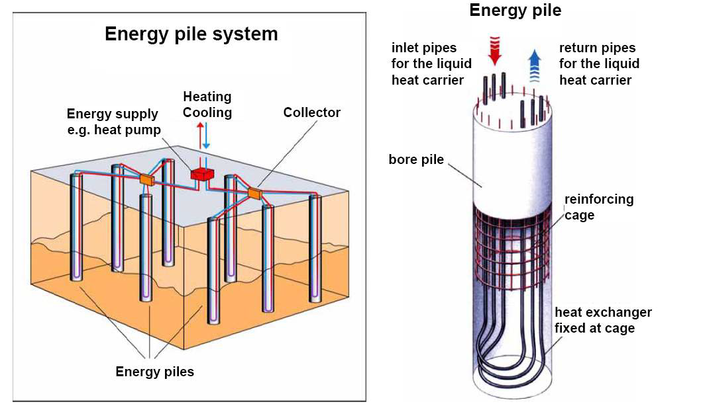
Thank You

